Slide 1

Introduction To VueJS
Nhóm 15
Dương Minh Mẫn - 19521821
Bùi Quốc Cường - 20521147
Nguyễn Thành Tài - 21521397
Phan Thị Bích Quyên - 22521224

Slide 2
What is VueJS
Progressive frontend framework
Best for Single Page Application (SPA)
Founder - Evan You (Independent Software Developer And Creator of Vuejs)
Releases
Initial (v0.10) in 2014
v1.0 in 2015
v2.0 in 2016
V3.4.25 (current)

Slide 3
Why Vue?
Easy to learn
Light weight (~22kb) - where Angular - ~111kb and React - 32 kb
Reactivity
Reusable components
Virtual DOM

Slide 4
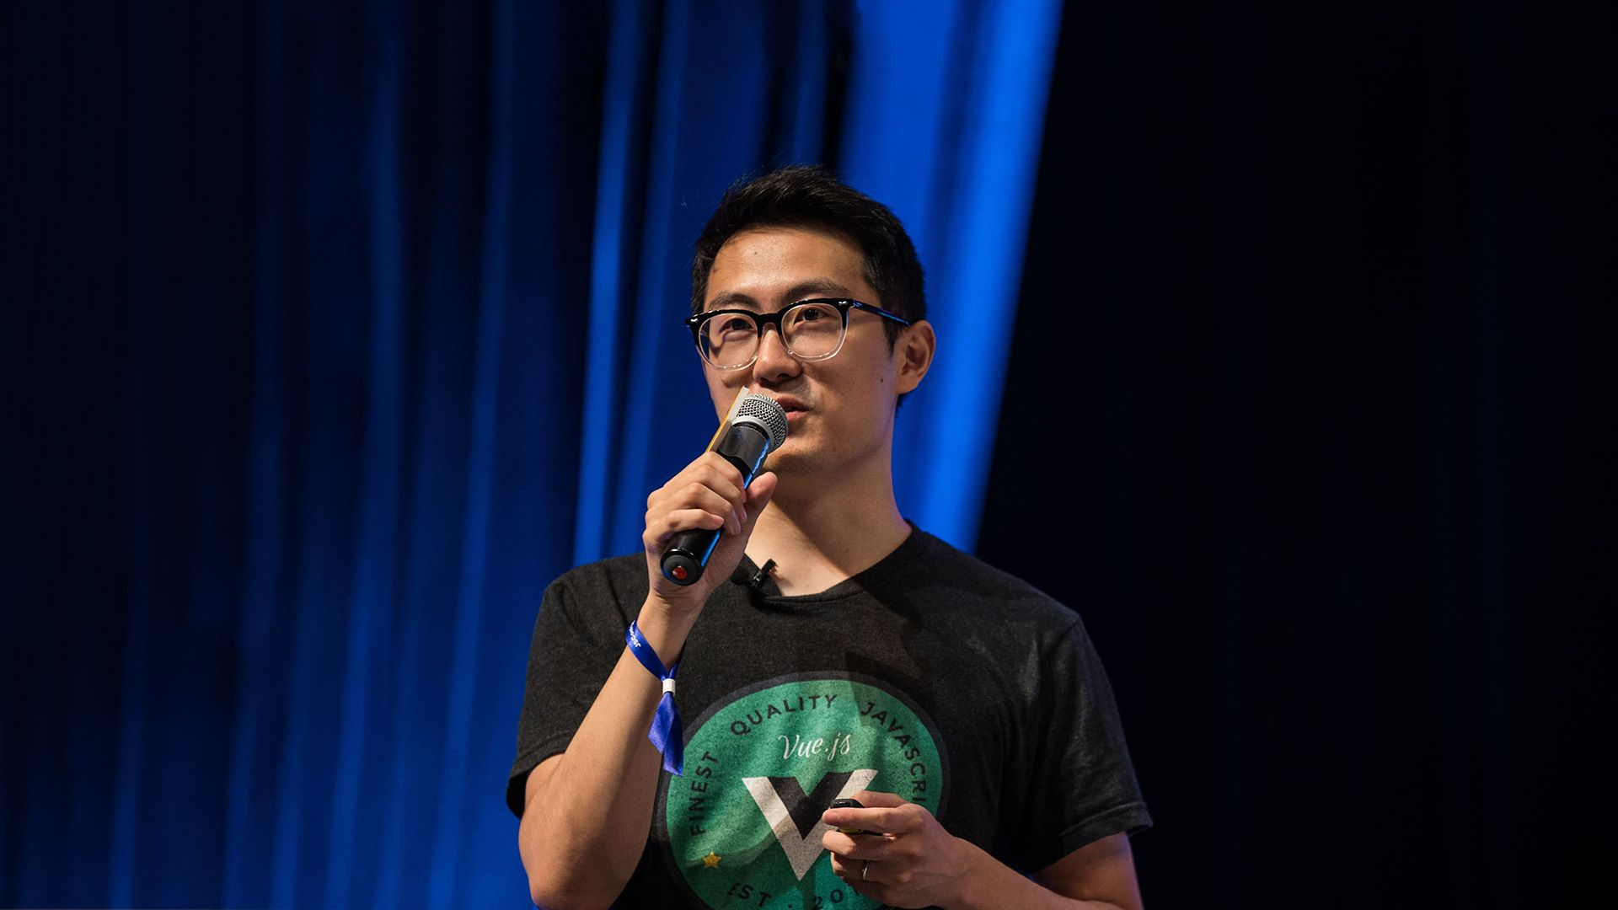


Evan You, 37
Creator of Vue.js & Vite

Slide 5



Slide 6
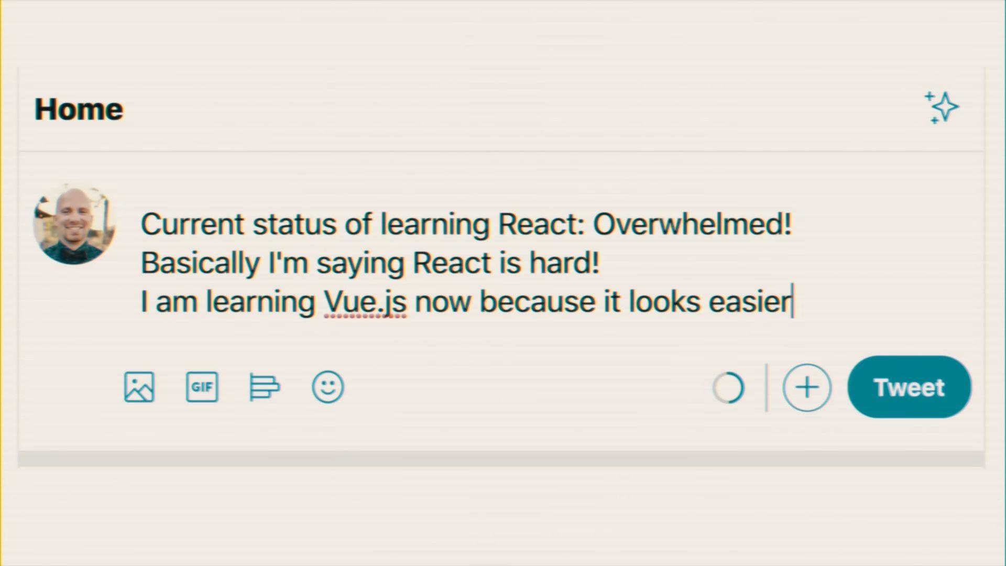

Slide 7




CÁC ÔNG LỚN CỦA TRUNG QUỐC HẬU THUẪN VUE.JS

Slide 8
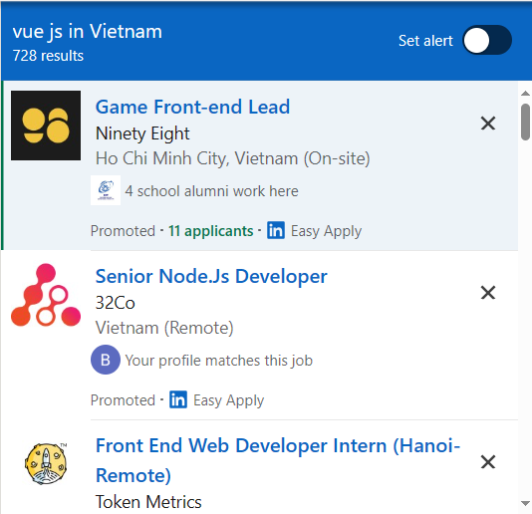
CƠ HỘI VIỆC LÀM
Hơn 728 công việc tại Tp HCM đang yêu cầu ứng viên có kiến thức về Vue.js!

Slide 9
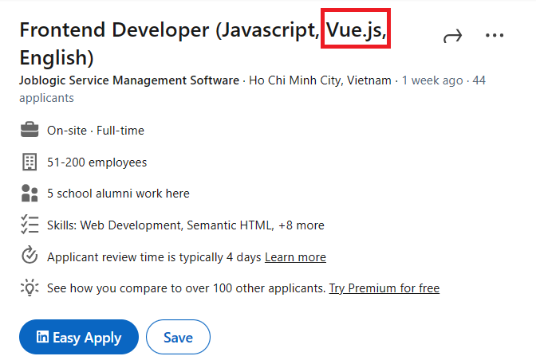

Slide 10
Quick Start - Hello Word

Slide 11
Hello Word - Installation (inject CDN)
<!-- development version, includes helpful console warnings -->
<script src="https://cdn.jsdelivr.net/npm/vue/dist/vue.js"></script>
Or
<!-- production version, optimized for size and speed -->
<script src="https://cdn.jsdelivr.net/npm/vue"></script>

Slide 12
Hello Word - Code
HTML
Output:
<div id="app">
{{ greetings }}
</div>
Hello Vue from UIT!
JavaScript
var app = new Vue({
el: '#app',
data: {
greetings: 'Hello Vue from UIT!'
},
})

Slide 13
Hello Word - Explaination
var app = new Vue({ /* Options */ });
Vue Instance
Options
el (string) - to plugin code to HTML
data (json of data)- add all properties found in data to vue’s reactivity system.
methods (json of function)- methods object which can be called from html using event bindings.
computed (json of function) - derived data property will be specified here
mounted (function) - this will be a lifecycle hook, called when mounted.
created (function) - this will be a lifecycle hook, called when created.
Many more...

Slide 14
Hello Word - Explaination
<h1> {{ greeting }} </h1>
Display data content to HTML page. And here are some more expression which will also work
{{ ‘Hello ‘ + name }}
{{ firstName + ‘ ‘ + lastName }}
{{ message.split(‘’).reverse().join(‘’) }}
{{ num + 1 }}
{{ isActive ? ‘Active’ : ‘Inactive’ }}

Slide 15
Rendering with Condition & Loop

Slide 16
Basic Rendering
Regular message rendering
Directive ( `v-once` )
Directive ( `v-html` )
<span>Message: {{ msg }}</span>
<span v-once>This will never change: {{ msg }}</span>
<div v-html="html"></div> <!-- html = "<ul><li>Hello</li><li>World</li></ul>" -->

Slide 17
Conditional Rendering - Directives
These are the directives which used for conditional rendering
v-show
v-if
v-else-if
v-else
( `v-show` ) Will keep element in the dom, and just change display style (none or block) ( `v-if` ) will remove entire element from the dom

Slide 18
Conditional Rendering (v-if, v-else)
HTML
Output:
<div id="app">
<span v-if="visible">Showing</span>
<span v-else>Hiding</span>
</div>
Showing
JavaScript
var app = new Vue({
el: '#app',
data: {
visible: true
}
})

Slide 19
Conditional Rendering - Use case
Show `No records` message when list is empty
When you want to create TAB like functionality
When there is some options which should show only when record has xyz flag (isActive for example)
Create toggle button to show and hide sidebar
And many more...

Slide 20
List Rendering
HTML
Output:
<div id="app">
<ul> <li v-for="i in fruits">{{i}}</li> <ul>
</div>
apple
banana
orange
JavaScript
var app = new Vue({
el: '#app',
data: {
fruits: ["apple", "banana", "orange"]
},
})

Slide 21
List Rendering (Use case)
List out bullet points
List backend collections
And many more...

Slide 22
Vue Instance LifeCycle

Slide 23
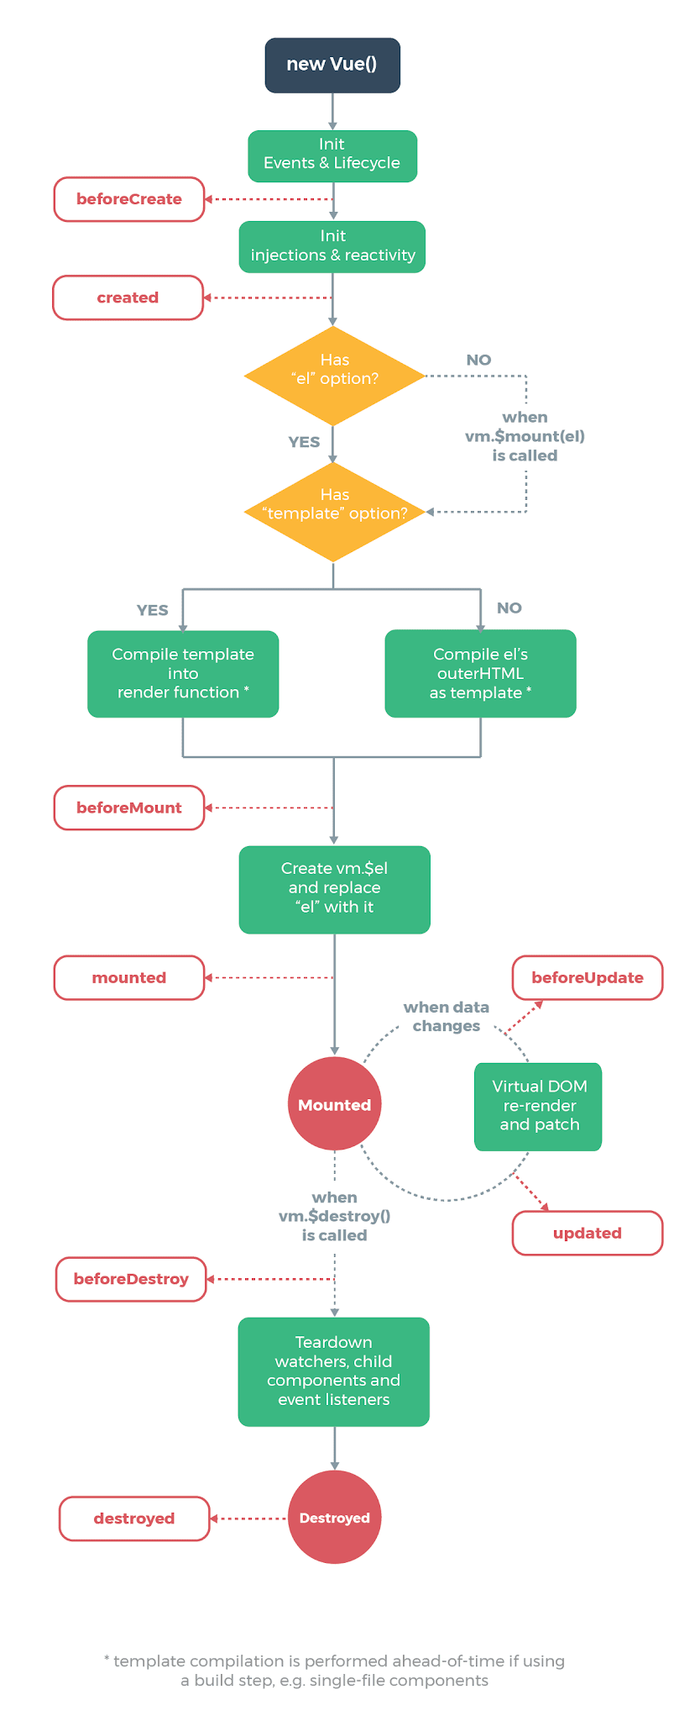
Life Cycle
Create instance `new Vue()`
Event & LifeCycle (framework’s part)
Injections & Reactivity (again framework’s part)
Check for option `el` or mount
If `el` is provided it will mount there
Other wise it will wait for function `vm.$mount(el)` to get called

Slide 24
Life Cycle
Check if `template` option provided
Then compile that template
Otherwise compile outer html of mounted element
Framework stuffs for mount them.
Virtual Dom will be there now.
Reactive updates of data

Slide 25
Life Cycle
Destroy call
Framework calls for destroy.

Slide 26
Directive ( `v-bind` )
This directive is used to reactively update html attribute.
<a v-bind:href="url"> ... caption ... </a>
Here href is the argument, which tells the v-bind directive to bind the element’s href attribute to the value of the expression url.
<a :href="url"> ... caption ... </a>
Only colon ( `:` ) is used as sorthand for `v-bind` directive

Slide 27
Directive ( `v-on` )
This directive listens to the dom events.
<button v-on:click="action"> ... caption ... </button>
Here it will listen click event triggered from dom element button and call action method specified in the methods option.
In simple words this code will call action method when some one click on the button.
<button @click="action"> ... caption ... </button>
at ( `@` ) is used as sorthand for `v-on` directive

Slide 28
Event Modifiers
Click
.stop
.prevent
.self
KeyUp
.enter
.tab
.delete
.up
.f1

Slide 29
Reactive Form Inputs

Slide 30
Directive ( `v-model` )
This directive is used to create two-way data bindings on form inputs.
Text
Multiline Text
Select
Checkbox
Radio

Slide 31
Text & Multiline text
<input v-model="message" placeholder="edit me"> <p>Message is: {{ message }}</p>
<textarea v-model="message" placeholder="add multiple lines"></textarea><br/> <span>Multiline message is:</span> <p style="white-space: pre-line;">{{ message }}</p>
This will apply changes right a way to following p tag as made changes in text box

Slide 32
Checkbox
Single checkbox, boolean value.
<input type="checkbox" id="checkbox" v-model="checked"> <label for="checkbox">{{ checked }}</label>
This will show true or false right next to checkbox, as we select or deselect them.

Slide 33
Radio button
<input type="radio" id="one" value="One" v-model="picked"> <label for="one">One</label> <br> <input type="radio" id="two" value="Two" v-model="picked"> <label for="two">Two</label> <br> <span>Picked: {{ picked }}</span>

Slide 34
Select
<select v-model="selected"> <option disabled value=""> Please select one </option> <option>A</option> <option>B</option> <option>C</option> </select>
<span>Selected: {{ selected }}</span>
new Vue({ el: '#app', data: { selected: ‘’ } })

Slide 35
Model modifiers
.lasy
Sync after `change` event, where `input` event was default.
.number
This modifier will automatic type cast to number.
.trim
It will trim input

Slide 36
v-model with components
Vue components allow you to build reusable inputs with completely customized behavior. These inputs even work with v-model!
We are not going in depth for this topic

Slide 37
Vue Component

Slide 38
Basic Syntax of Vue Component
Vue Component can be defined like this.
Vue.component(‘comp-name’, { template: ‘#compo’, // template id or direct html data: function() { return {}; } // return properties json object props: [‘a’] // input from parent // Other options });

Slide 39
Vue Component
Basically, components are reusable vue instance with name.
Template option can be HTML or template id like `#comp-template` this.
Template must contain a single root element.
Here data option will be function (where in vue instance [new Vue] has data as object)
Data can be pass to child component using `props` option
Vue components can be used multiple times with separate data for each instance

Slide 40
Counter button
Let’s see an example of vue component - Create a counter button.
<div id="app"> <counter></counter> </div>
<template id="cbtn"> <div> <button v-on:click="count += 1"> {{ count }} Clicks </button> </div> </template>
Vue.component('counter', { template: '#cbtn', data: function() { return {count: 0}; } });
var app = new Vue({ el: '#app' });

Slide 41
`props` to pass data to child component
Let’s see an example of vue component - with multiple instance with their own data and props from parent.
<div id="app"> <counter name="apple"></counter> <counter name="banana"></counter> </div>
<template id="cbtn"> <button v-on:click="count += 1"> {{ count }} {{ name }} </button> </template>
Vue.component('counter', { template: '#cbtn', props: ['name'] data: function() { return {count: 0}; } });
var app = new Vue({ el: '#app' });

Slide 42
Concepts we left to cover up
Slots in Component
Event
Event in Vue Instance
Vue Component Event
Event Bus (Separate Vue instance for events)
Routing using vue-router (which is most useful for SPA)
State management using vuex
And many more...

Slide 43
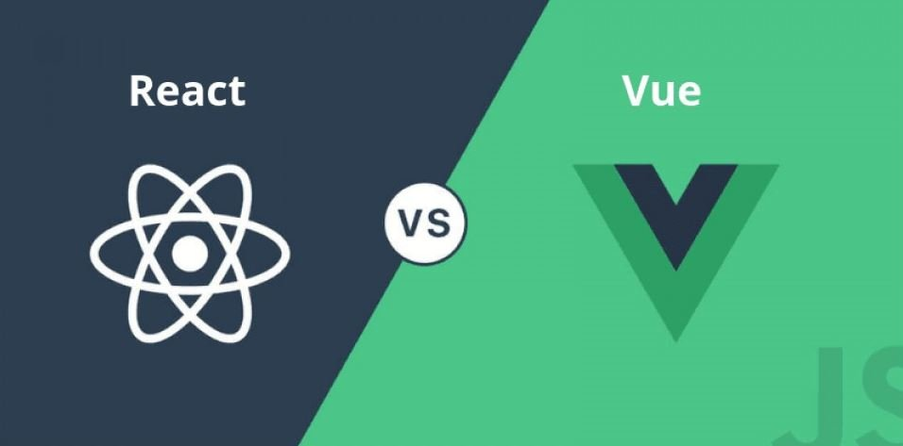

Slide 44
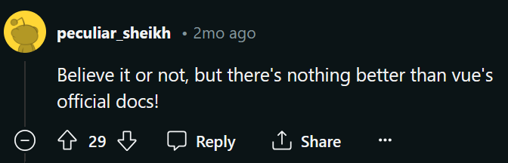
Recommended Learning Materials

Slide 45
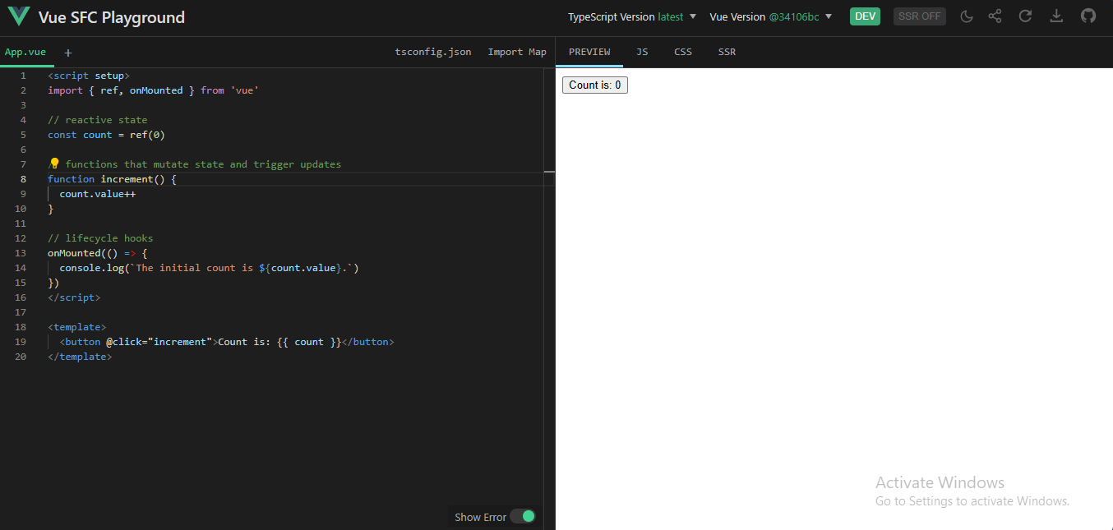

Slide 46
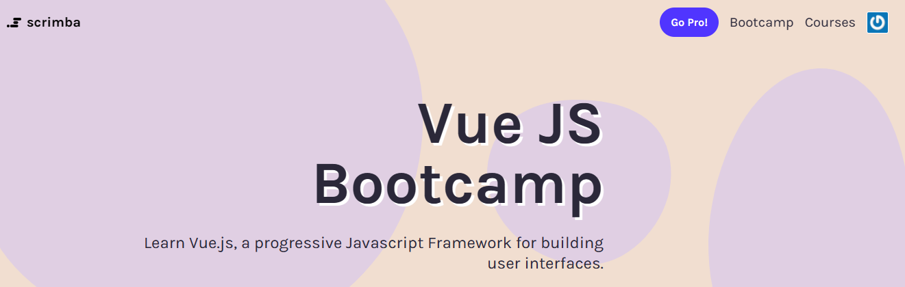
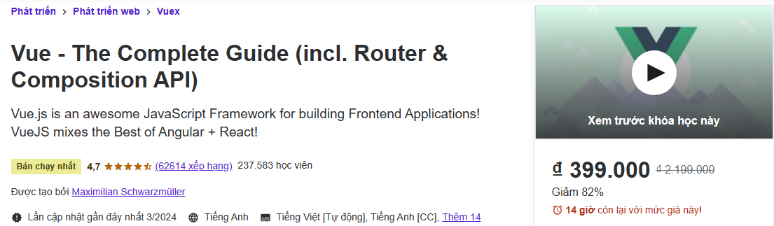

Slide 47
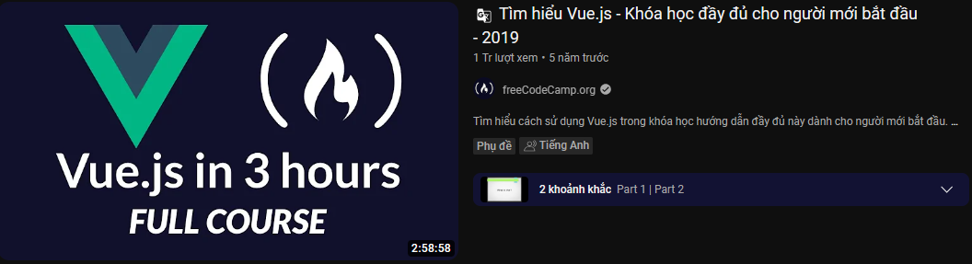
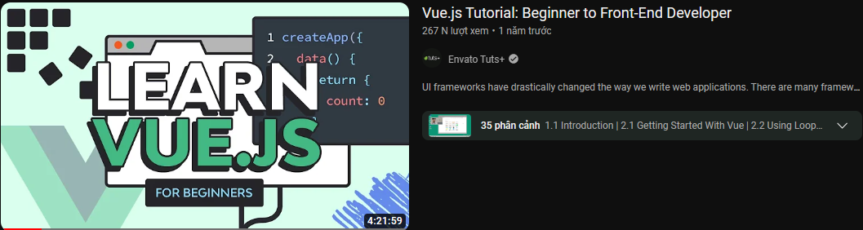

Slide 48

Step 1: Turn on your Laptop
Step 2: Pick IDEs
Step 3: Code
🔥 TUTORIAL HELL 😈

Slide 49
DEMO VUE.JS

Slide 50

THANKS FOR YOUR ATTENTION

